Slide 1
Lecture 5
Entity-Relationship Model (1)

Slide 2
Entity-Relationship Model
Design Process
Modeling
Constraints
E-R Diagram
Design Issues
Weak Entity Sets
Extended E-R Features
Design of the Bank Database
Reduction to Relation Schemas
UML

Slide 3
Design Process
Real-world applications tend to be highly complex
  No one person understands the complete data needs.
  Ideas should be shared among designers and the users.
  Represent the needs in a high-level fashion
  Translate the requirements into lower levels of design later on
Characterize fully the data needs
  Interact with domain experts and users to get a specification of user requirements
Conceptual Design
Specification of functional requirements
Logical design and physical design

Slide 4
Design Process
In database design, we
  Identify various types of “things”
  Capture how these “things” are related to each other
Avoid two major pitfalls – KEEP IN MIND
  Redundancy
    Repeat information
  Incompleteness
    Difficult or impossible to model certain aspects
Choose and follow good designs
Combination of both science and “good taste”

Slide 5
Modeling
A database can be modeled as:
  a collection of entities, and
  relationships among entities.
An entity is an object that exists and is distinguishable from other objects.
  Example: a specific person, company, event, plant…
Entities have attributes
  Example: people have names and addresses
An entity set is a set of entities of the same type that share the same properties.
  Example: set of all persons, companies, trees, holidays…

Slide 6
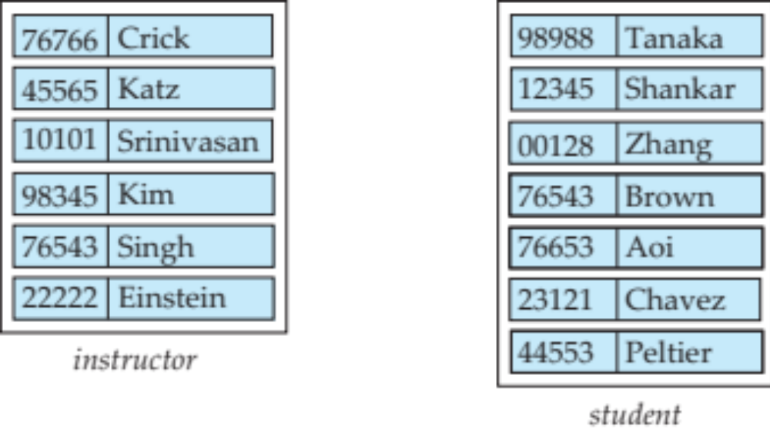
Entity Sets – instructor and student
instructor_ID instructor_name student_ID student_name

Slide 7
Relationship Sets
A relationship is an association among several entities
Example:
44553 (Peltier) advisor 22222 (Einstein)
student entity relationship set instructor entity
A relationship set is a mathematical relation among n ≥ 2 entities, each taken from entity sets
{(e₁, e₂, … e_{n}) | e₁ ∈ E₁, e₂ ∈ E₂, …, e_{n} ∈ E_{n}}
where (e₁, e₂, …, e_{n}) is a relationship
  Example:
  (44553, 22222) ∈ advisor
NOTE: Relationship comes up with Entities, while Relation concerns tuples (rows) and attributes (columns).

Slide 8

Relationship Set advisor

Slide 9

Relationship Sets (Cont.)
An attribute can also be property of a relationship set.
  For instance, the advisor relationship set between entity sets instructor and student may have the attribute date which tracks when the student started being associated with the advisor

Slide 10
Degree of a Relationship Set
Refers to number of entity sets that participate in a relationship set.
Binary relationship sets – involving two entity sets
  Generally, most relationship sets in a database system are binary.
Relationship sets may involve more than two entity sets, but they are rare.
  Example: students work on research projects under the guidance of an instructor.
    relationship proj_guide is a ternary relationship between instructor, student, and project

Slide 11
Attributes
An entity is represented by a set of attributes, that is descriptive properties possessed by all members of an entity set.
Domain – the set of permitted values for each attribute
  instructor_name– set of all text strings of a certain length
  student_name– set of all text strings of a certain length
Example:
instructor= (instructor_ID, instructor_name)
student= (student_ID, student_name)

Slide 12
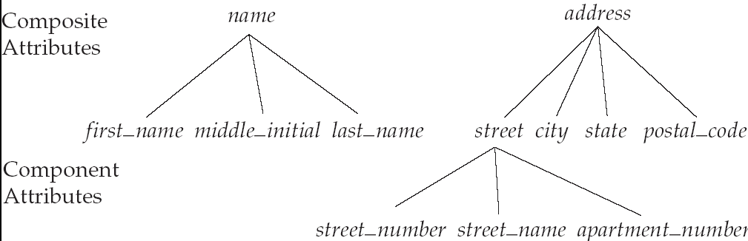
Attribute Types
Simple and composite attributes
  “address” may be structured as a composition of subparts.

Slide 13
Attribute Types
Simple and composite attributes
  “address” may be structured as a composition of subparts.
Single-valued and multi-valued attributes
  “phone_number” may have a set of values for a specific entity.
  Number of values may have upper or lower bounds.
Derived attributes
  Can be computed from other attributes (by aggregation, or by arithmetic calculations)
    The age attribute can be calculated with date_of_birth.
      Stored attribute (or base attribute)

Slide 14
Constraints
Mapping Cardinality
  One-to-one
  One-to-many
  Many-to-one
  Many-to-many
Keys
  Keys for entities
  Keys for relationships
Participation Constraints
  Total participation
  Partial participation

Slide 15
Mapping Cardinalities
Express the number of entities to which another entity can be associated via a relationship set.
Most useful in describing binary relationship sets.
For a binary relationship set the mapping cardinality must be one of the following types:
  One to one
  One to many
  Many to one
  Many to many

Slide 16
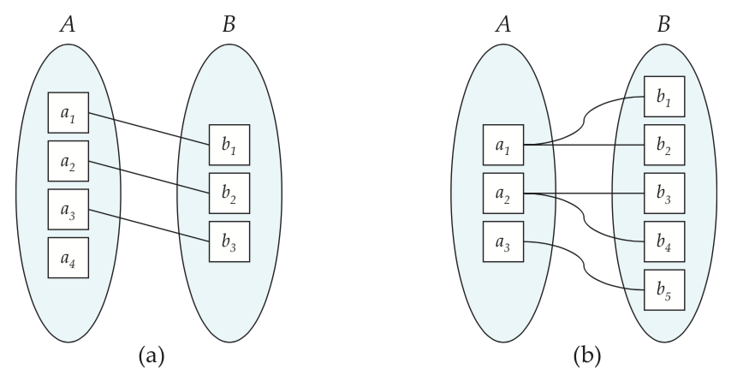
Mapping Cardinalities
One to one
One to many
Note: Some elements in A and B may not be mapped to any
elements in the other set

Slide 17
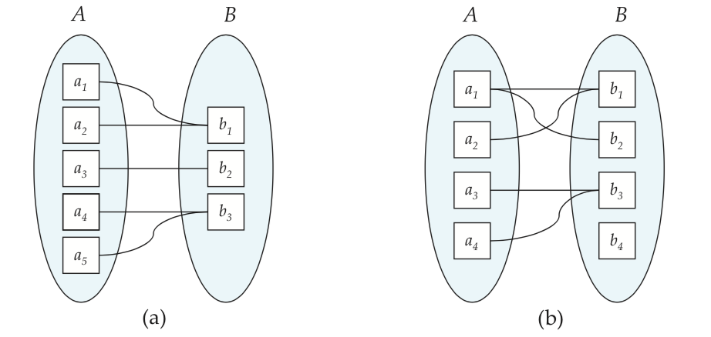
Mapping Cardinalities
Many to one
Many to many
Note: Some elements in A and B may not be mapped to any
elements in the other set

Slide 18
Keys
A super key of an entity set is a set of one or more attributes whose values uniquely determine each entity.
A candidate key of an entity set is a minimal super key
  student_ID is candidate key of student
  dept_name is candidate key of department
Although several candidate keys may exist, one of the candidate keys is selected to be the primary key.

Slide 19
Keys for Relationship Sets
A similar mechanism to distinguish among relationships
Finding super keys for relationship sets
  The combination of primary keys of the participating entity sets forms a super key of a relationship set.
Deciding candidate keys
  Must consider the mapping cardinality of the relationship set
Selecting a primary key
  Need to consider semantics of relationship set in case of more than one candidate key
Remind keys for relations? – We now consider keys for entity sets and relationship sets.

Slide 20
Participation Constraints
Total participation (indicated by double line):
  Every entity in the entity set participates in at least one relationship in the relationship set
    e.g., participation of student in advisor relation is total
      Every student must have an associated instructor
Partial participation
  Some entities may not participate in any relationship in the relationship set
    e.g., participation of instructor in advisor is partial
      There can be instructors who do not have an associated student.

Slide 21
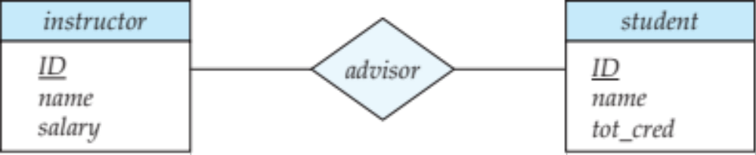
Entity-Relationship Diagram (ERD)
A Relationship Set
An Entity Set

Slide 22
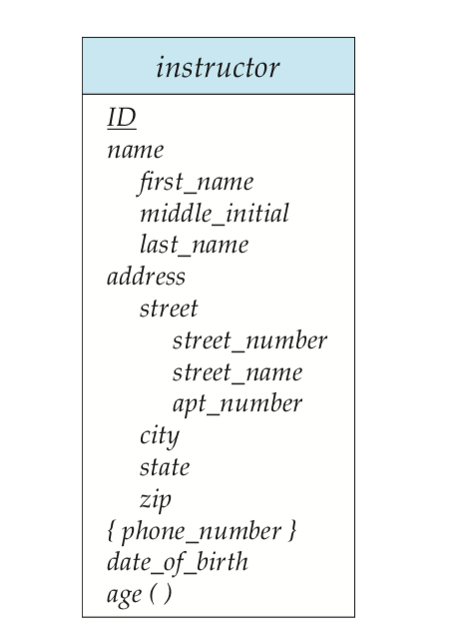
E-R Diagram With Composite, Multivalued, and Derived Attributes
Primary key
A composite attribute
A multivalued attribute
A derived attribute

Slide 23
An alternative representation
name
name
salary
ID
tot_cred
ID
advisor
instructor
student
An Entity Set
A Relationship Set
An Attribute
Double ellipses: multivalued attributes
Dashed ellipses: derived attributes
Underline: a primary key attribute

Slide 24
Cardinality Constraints
We express cardinality constraints by drawing either:
    a directed line (→), signifying “one” , or
    an undirected line (—), signifying “many”
  between the relationship set and the entity set.
  When we are talking about cardinality constraints, we refer to relationships, but the cardinality actually has effects on the entity sets participating in a relationship set.
  In other words, the cardinality reflects the number of times each entity participates in relationships in a relationship set.
    So, A-to-B is one-to-many, for example, actually means one A is associated with “many” B and one B is associated with “one” A (or is not associated with any A at all), via a certain relationship.
    Therefore, one A may show itself many times in the relationship set.

Slide 25

One-To-Many Relationship
one-to-many relationship between an instructor and a student
  an instructor is associated with several (including 0) students via advisor
  a student is associated with at most one instructor via advisor

Slide 26
Many-To-One Relationships
In a many-to-one relationship between an instructor and a student,
  an instructor is associated with at most one student via advisor,
  and a student is associated with several (including 0) instructors via advisor

Slide 27
Many-To-Many Relationship
An instructor is associated with several (possibly 0) students via advisor
A student is associated with several (possibly 0) instructors via advisor

Slide 28
One-to-one relationship
One-to-one relationship between an instructor and a student :
  A student is associated with at most one instructor via the relationship advisor
  An instructor is associated with at most one student via advisor

Slide 29


Relationship Sets with Attributes
A relationship set with an attribute
An attribute attached to a relationship set

Slide 30
An alternative representation
date
name
name
salary
ID
tot_cred
ID
advisor
instructor
student
A relationship set with an attribute
An attribute attached to a relationship set

Slide 31

Participation Notations in E-R Diagrams
Total participation
  Indicated with double lines
Partial participation
  Indicated with a normal single line

Slide 32

Alternative Notation for Cardinality Limits
A way to indicate more complex cardinality constraints
  An edge can have an associated minimum and maximum cardinality.
  What is this notation equivalent to?
    An instructor can advise 0 or more students. A student must have exactly 1 advisor; cannot have multiple or no advisors.
Cardinality limits can also express participation constraints

Slide 33

Ternary Relationship Sets
A ternary relationship set
  A relationship set associated with three entity sets
  students work on research projects under the guidance of an instructor.
  What if an instructor can guide at most one student in a project?

Slide 34
Cardinality Constraints on Ternary Relationships
To express the previous cardinality constraint, we put:
  an arrow from proj_guide to project
    A student may have two instructors, but each instructor should guide the student on a different project.
    An instructor may have two students, but each student should participate in a different project.

Slide 35
Cardinality Constraints on Ternary Relationships
To avoid confusion we allow at most one arrow out of a ternary (or greater degree) relationship to indicate a cardinality constraint.
  If there is more than one arrow, e.g. a ternary relationship R between A, B and C with arrows to B and C…
  1. each A entity is associated with a unique entity from B and C; or
  2. each pair of entities from (A, B) is associated with a unique C entity, and each pair (A, C) is associated with a unique B
  If only one arrow is allowed, the two interpretation will be equivalent.

Slide 36
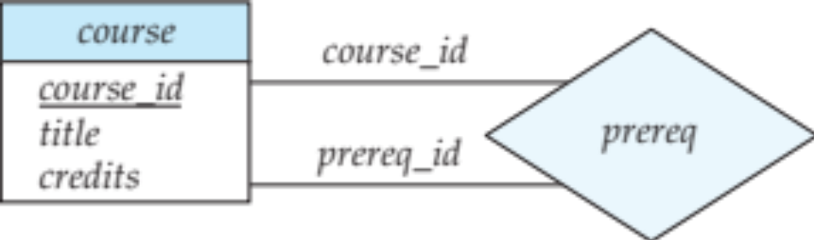
Roles
Role
Entity sets of a relationship need not be distinct.
In the above example
  The labels “course_id” and “prereq_id” are called roles
Role labels are optional, and are used to clarify semantics of the relationship

Slide 37
Design Issues
Basic Issues
  Use of entity sets vs. attributes
  Use of entity sets vs. relationship sets
  Binary relationships vs. non-binary relationship sets
  Placement of relationship attributes

Slide 38

Use of Entity Sets vs. Attributes
Example
  Telephone may be modeled as an entity set, while instructor_name should not be treated as an entity set.
Choice mainly depends:
  on the structure of the university enterprise being modeled, and
  on the semantics associated with the attribute in question.
Mistakes
  Use primary key of an entity set as an attribute of another entity set
  Designate primary-key attributes of related entity sets as attributes of the relationship set

Slide 39

Use of Entity Sets vs. Relationship Sets
Example
  Take is a relationship set connecting student and section; can may be modeled as an entity set.
A possible guideline
  Designate a relationship set to describe an action that occurs between entities
    This can also be useful in choice between attributes and relationships.
    Only a possible guideline (not always true)

Slide 40
Binary vs. n-ary Relationship Sets
Relationships in databases are often binary
A n-ary relationship set may show more clearly that several entities participate in a single relationship
Possible to replace any non-binary (n-ary) relationships by a number of distinct binary relationship sets
  Some relationships that appear to be non-binary may be better represented using binary relationships
    A ternary relationship parents versus two binary relationships, father and mother
  But there are some relationships that are naturally non-binary
    Example: proj_guide

Slide 41
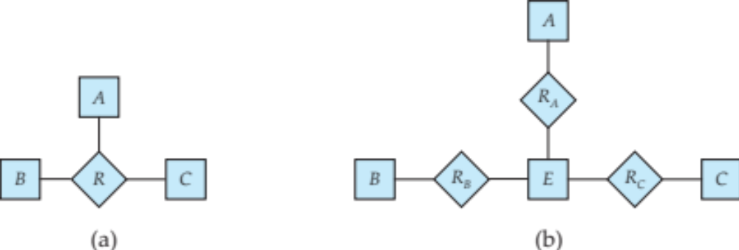
Binary vs. n-ary Relationship Sets
Converting Non-Binary Relationships to Binary Form
  Create an artificial entity set E.
  Replace R between entity sets A, B and C by an entity set E, and three relationship sets:
1. R_{A}, relating E and A 2.R_{B}, relating E and B 3. R_{C}, relating E and C
  Create a special identifying attribute for E
  Add any attributes of R to E
  For each relationship (a_{i} , b_{i} , c_{i}) in R:
1. create a new entity e_{i} in the entity set E 2. add (e_{i} , a_{i} ) to R_{A}
3. add (e_{i} , b_{i} ) to R_{B} 4. add (e_{i} , c_{i} ) to R_{C}

Slide 42
Binary vs. n-ary Relationship Sets
Converting Non-Binary Relationships to Binary Form (contd.)
  Need to translate constraints
    Translating all constraints may not be possible
    There may be instances in the translated schema that cannot correspond to any instance of R

Slide 43
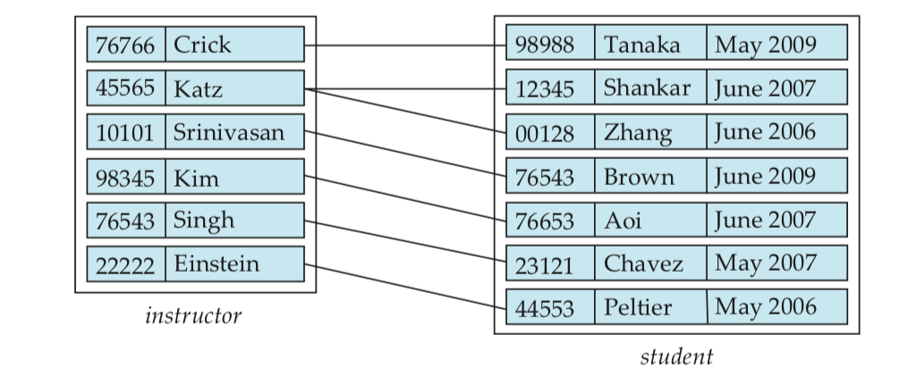
Placement of Relationship Attributes
Mapping Cardinalities
  Can make date an attribute of student, instead of a relationship attribute, if each student can have only one instructor
    i.e. the relationship from student to instructor is many to one, or equivalently, instructor to student is one to many

Slide 44
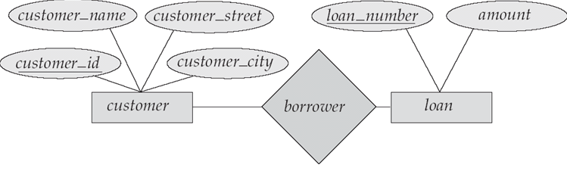
ERD Example

Slide 45
In-class Exercise
P315 7.1: Car Insurance Company
    Customer
    Car
    Accidents
    Insurance Policy (保单)
    Premium Payments (保费支付)

Slide 46
Next Lecture
Entity-Relational Model (2)

